Slide 1
Data Science Talk: Survey Analysis
December 16 2019
Analytics and Data Science
Analytique et Science des données

Slide 2
Overview
1
Cleaning your data
2
Data Exploration
3
Data Analysis
4
Discussion

Slide 3
Cleaning

Slide 4
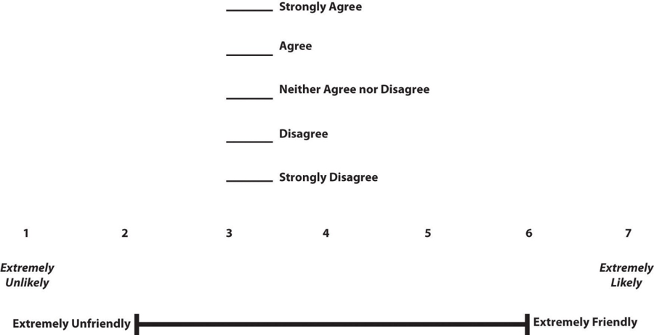
Data Standardization
Ensure all values mean the same from one row to the next.
Important when combining data sources, or when data model has changed over time.
0
5

Slide 5
Data Standardization
Combining Survey Data
Often, we will want to use survey data from multiple sources. Is it possible? Sometimes.
Checklist to combine data:
Keywords
Satisfaction, frequency
Time Reference
How many coffees did you have today?
How many times a week do you meet with coworkers?
Method
Single question
Type Scale
Verbal, Semantic distance etc.
Length of scale
5 ( ex. 5-point Likert Scale)
Variation
What are you measuring? ( Agree- Disagree)
https://www.ncbi.nlm.nih.gov/pmc/articles/PMC3971463/
Notes:
Verbal scale example - https://help.surveyanyplace.com/en/support/solutions/articles/35000041597-verbal-scale
Semantic distance example = distance between meanings of 2 concepts https://aidaform.com/blog/semantic-differential-scale-definition-examples.html
Very minimal differences between answers to these checklist items can allow you to combine data.
The most forgiving are length of scale, and sometimes variation . i.e. I am satisfied with a one hour lunch break( agree / disagree) vs. Rate your satisfaction of the following: One hour lunch break (unsatisfied to satisfied)

Slide 6
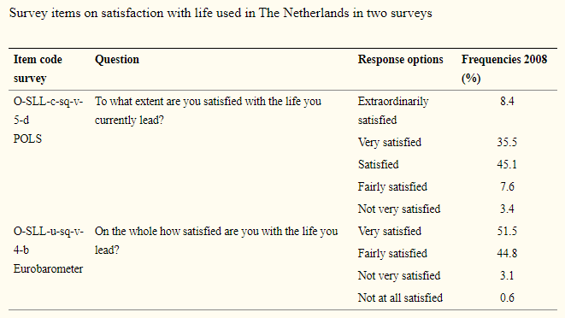
Data Standardization
Combining Survey Data
Often, we will want to use survey data from multiple sources. Is it possible? Sometimes.
Satisfied
https://www.ncbi.nlm.nih.gov/pmc/articles/PMC3971463/
Notes:
Article goes over different methods including using a reference scale (another survey asking the same question, approx. 10 point scale)

Slide 7
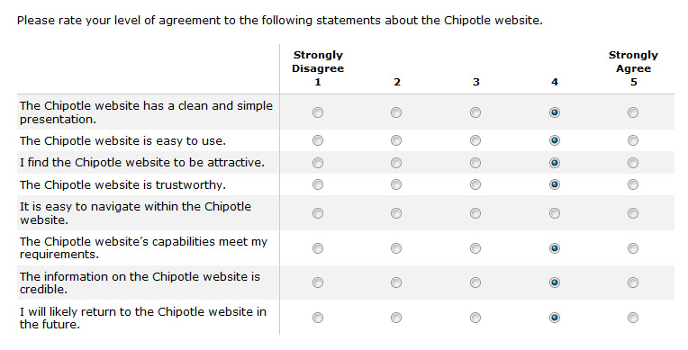
Missing Data
Reasons for missing data
Error in the data collection process
Certain measurements are not applicable
Fields left blank (intentionally, or unintentionally)
Image source, examples: https://measuringu.com/handle-missing-data/

Slide 8
Missing Data
Reasons for handling missing data
Most tools are unable to handle missing data
Missing values can produce unpredictable results
How to identify :
Blank cells, or cell with whitespace
Placeholder strings
NaN (Not a Number)
NULL value
Often used in relational databases
Types of missing data:
Missing at random
Missing completely at random
Missing not at random
Removing this type of data may introduce bias
How can I tell if its missing at complete random or at random?
Chi- squared
Notes:
Types of missing data explanation : https://www.theanalysisfactor.com/missing-data-mechanism/
Example of missing at random : Weight being answered by men but not by women. Relationship between propensity of missing values, but not of the missing data itself
Missing completely at random: NO relationship at all between missing data and any other variable
Missing not at random: For example, employee satisfaction survey. Those who are the least satisfied, might stop the survey and not finish. This needs to be explained during analysis

Slide 9
Data Exploration

Slide 10
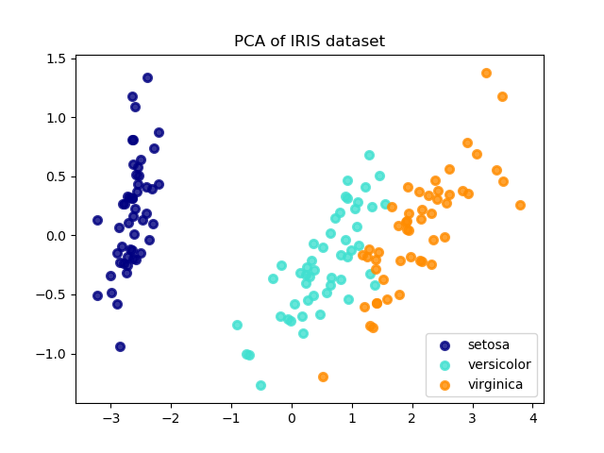
PCA
Main Goals
Reduces input variables into a smaller set of principal components that represent most of the variance in the original variables.
Remove unrelated variables
Reduce redundancy
Remove multicollinearity
https://scikit-learn.org/stable/modules/decomposition.html
Notes:
Remove unrelated variables: If you get a PC with a single variable, it can mean it is not related to the other variables in the study. And could be measuring as different construct
Remove redundancy: variables measuring the same underlying construct are usually correlated, will reduce it into one component
Remove multicollinearity: For highly correlated variables, component scores can be used instead of the original variables

Slide 11
PCA
Assumptions:
Multiple variables measured on continuous level (can be ordinal)
No distinction between independent and dependent variables
Linear relationship between all variables
Based off of Pearson correlation (linear)
Scatter plot to check
No outliers
Approx. 3 standard deviations away from mean
Large sample size
At least 5-10 cases PER variable
Notes:
Remove unrelated variables: If you get a PC with a single variable, it can mean it is not related to the other variables in the study. And could be measuring as different construct
Remove redundancy: variables measuring the same underlying construct are usually correlated, will reduce it into one component
Remove multicollinearity: For highly correlated variables, component scores can be used instead of the original variables

Slide 12
PCA
Example
315 job applicants fill out a 25 question (Likert scale) survey. The survey is meant to measure 4 different constructs.
Motivation : Question3,4,5,6,7,8,12,13
Dependability : Question 2,14,15,16,17,18,19
Enthusiasm : Question 20,21,22,23,24,25
Commitment: Question 1,9,10,11
Notes:
Remove unrelated variables: If you get a PC with a single variable, it can mean it is not related to the other variables in the study. And could be measuring as different construct
Remove redundancy: variables measuring the same underlying construct are usually correlated, will reduce it into one component
Remove multicollinearity: For highly correlated variables, component scores can be used instead of the original variables

Slide 13
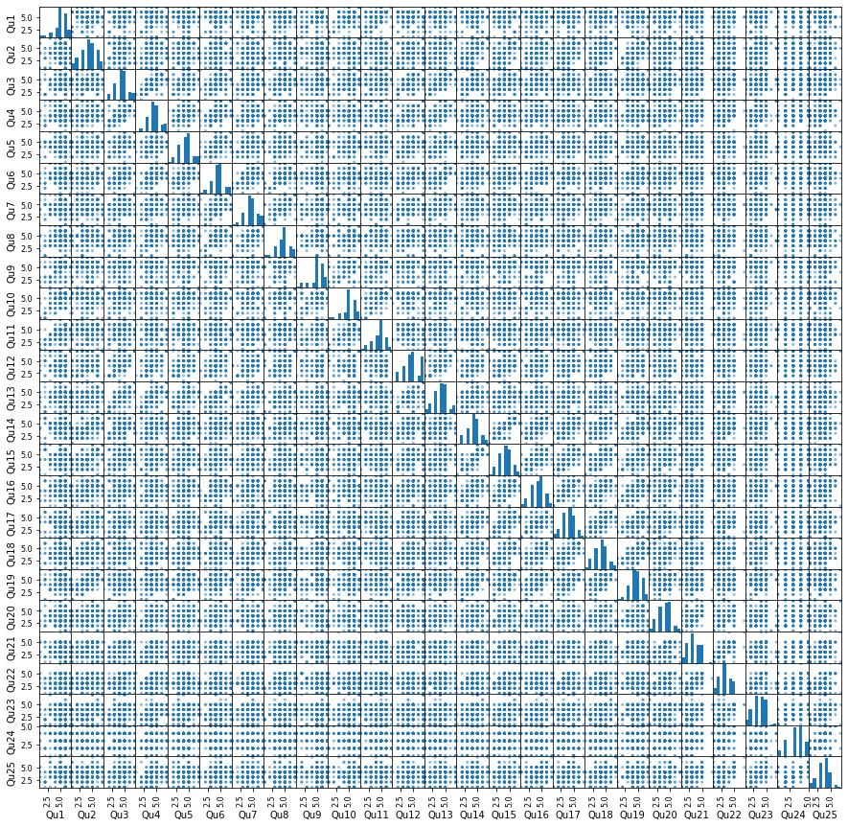
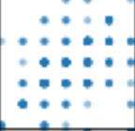
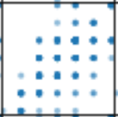
PCA
Assumptions:
Linear relationship between all variables
Based off of Pearson correlation (linear)
Scatter plot to check
Notes:
If data is nonlinear, PCA response is not valid.
There is some wiggle room and should be thought of as approximately linear, however non-linear data should use non-linear dimension reduction.
PCA is really just an axis rotation/transformation, so linear data is needed.

Slide 14
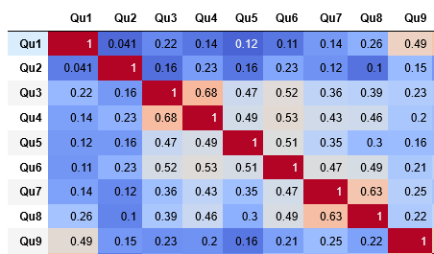
PCA
Assumptions:
Linear relationship between all variables
Based off of Pearson correlation (linear)
Scatter plot to check
Notes:
If checking correlation numerically, each variable should have AT LEAST one correlation greater than 0.3 with another variable
If there is a variable without a linear correlation with another remove it from analysis.

Slide 15

PCA
Assumptions:
Large sample size
At least 5-10 cases PER variable (or approx. 150 reponses)
Tests:
Kaiser Meyer Olkin (KMO) of data set
KMO of each variable
Bartlett’s test of sphericity (p≤0.05)
Kaiser (1974)
KMO | Meaning
KMO≥ 0.9 | Marvelous
0.8≤ KMO < 0.9 | Meritorious
0.7≤ KMO <0.8 | Middling
0.6≤ KMO <0.7 | Mediocre
0.5≤ KMO <0.6 | Miserable
KMO< 0.5 | Unacceptable
KMO all values- min 0.72
Notes:
KMO min is considered 0.6 , PCA is considered good around kmo = 0.8
Kmo measures variance and observations in each variable
If variables have kmo less than 0.5 consider removing it from the analysis
Bartlett test is variables are unrelated ( by testing against identity matrix), if statistically significant reject null hypothesis and continue with analysis

Slide 16
PCA
Assumptions:
No outliers
Approx. 3 standard deviations away from mean
Use component scores to check for outliers.
Notes:
Remove unrelated variables: If you get a PC with a single variable, it can mean it is not related to the other variables in the study. And could be measuring as different construct
Remove redundancy: variables measuring the same underlying construct are usually correlated, will reduce it into one component
Remove multicollinearity: For highly correlated variables, component scores can be used instead of the original variables

Slide 17
PCA
Retaining components
Eigenvalue-one criterion
Variable with eigenvalue less than one gets dropped
Total variance explained (Eigenvalue/# of variables)*100%
Each variable should explain min 5-10% of variance
Cumulative variance
Retain all components that explain at least 60-70% of variance
Interpretability criterion
Simple structures (use component matrix)
Scree plot
Look for inflection point
Notes:
If not specified PCA will produce the same amount of components as there are variables ( as this would explain the most variance)
To determine the number of components to keep, use one of these methods

Slide 18
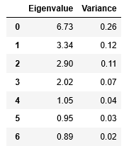
PCA
Retaining components
Eigenvalue-one criterion
Variable with eigenvalue less than one gets dropped
First 5 components would be retained
…
Notes:
KMO min is considered 0.6 , PCA is considered good around kmo = 0.8
If variables have kmo less than 0.5 consider removing it from the analysis

Slide 19
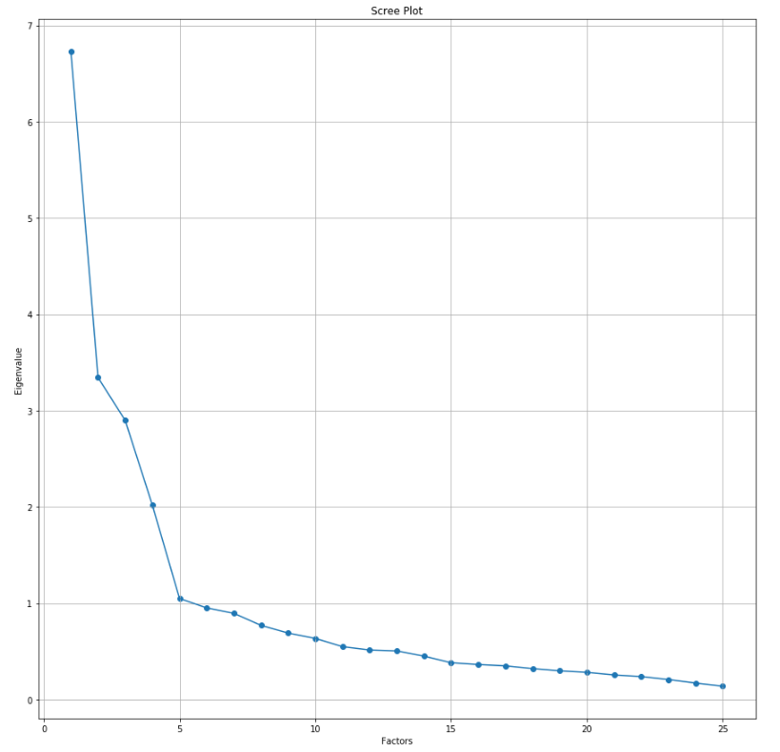
PCA
Retaining components
Scree plot
Look for inflection point
Inflection point
Notes:
Retain everything before the inflection point – so the first 4 components

Slide 20
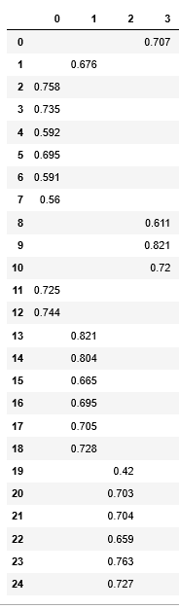
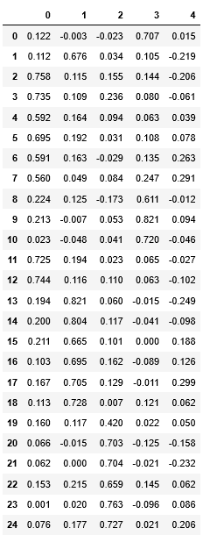
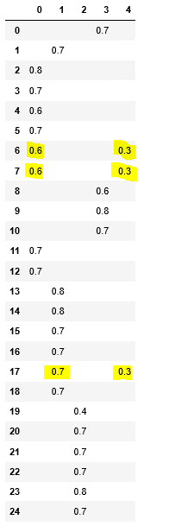
PCA
Retaining components
Interpretability – use loading table
Components
Components
Varimax rotated component matrix
Supress coefficients with less than 0.3
Questions
So 4 components will be retained
Notes:
Loading table presents correlations
You want the simplest form – generally components with at least 3 variables, no variables with more than one component
This is where outliers would be checked

Slide 21
Cronbach’s Alpha
Measure of internal consistency or reliability
Questions grouped together to measure an underlying construct is called a scale.
Surveys can contain many scales
Sometimes the sum of a scale is used to measure a construct
Determines how well questions are grouped together, but does not determine the number of dimensions or constructs
***Each question needs to contribute to the scale in the same way ***

Slide 22

Cronbach’s Alpha
Example:
Please indicate your opinion of Maddy using the scale below.
______ I think that Maddy is a unicorn
______ I do not think Maddy is a unicorn
Measuring underlying construct (Unicorn)
We have to inverse the scale if question language is contradictory.
5
1
5

Slide 23
Cronbach’s Alpha
Interpreting results
By question:
Pearson correlation
Between question sum and sum of other questions ≥0.3
Squared multiple correlation ( r² )
Acceptable value varies by study (human etc.)
By group of questions:
Cronbach’s alpha
Generally α≥0.7 is a good level of internal consistency
Notes:
R2 is the multiple regression value that multiplies the dependent variable
High Rsquared isn’t always good, can check residuals from more info. https://blog.minitab.com/blog/adventures-in-statistics-2/regression-analysis-how-do-i-interpret-r-squared-and-assess-the-goodness-of-fit

Slide 24

Cronbach’s Alpha
Example:
Let’s continue our first example, and measure the reliability of the questions measuring Enthusiam.
We take the observations for questions 20-25:
Cronbach’s Alpha of 0.82
What happens if we remove question 20?
Take observations from Q 21-25
Cronbach’s Alpha of 0.84

Slide 25
Data Analysis

Slide 26
Chi Square
Determines if there is an association between 2 nominal variables
Compares expected frequencies and observed frequencies
Can use on ordinal data (but you lose the order)
Can determine magnitude of association
Assumptions:
Two nominal variables
Independence of observations
Cross-sectional data
Expected count should be ≥5
Notes:
Independence of observations= no relationship between observations in each group of the independent variable or between groups of the independent variable
Cross-sectional = should represent the population more or less
Observations should have at least 5 counts in each cell, however, general rule is at least 80% have count of 5 or more
If condition not met collapse some categories

Slide 27
Chi Square
Example Assumptions:
Two nominal variables
Property type
Flat, bungalow, detached house, terrace
Buyer type
Single male, single female, married couple, family
Independence of observations
Study design
Cross-sectional data
Study design
Expected count should be ≥5
Need to run test and reevaluate
Notes:
Independence of observations= no relationship between observations in each group of the independent variable or between groups of the independent variable
Cross-sectional = should represent the population more or less
Observations should have at least 5 counts in each cell, however, general rule is at least 80% have count of 5 or more
If condition not met collapse some categories

Slide 28
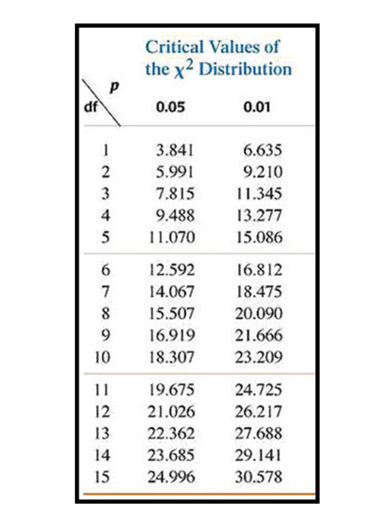
Chi Square Hypotheses
Null hypothesis:
H_{o} : no association between the 2 nominal variables
Alternative hypothesis:
Valid for degrees of freedom and values in table
H₁: There is an association between the 2 nominal variables
Degrees of freedom (df) = (rows-1)*(columns-1)
Notes:
Tests against the null hypothesis, if p is less than or equalo to 0.05 with the df in table, then the null hypothesis is rejected, and alternation hypothesis accepted.
Values in the rows are the range of chi-squared values accepted for the respective values of df and p

Slide 29
Chi Square Hypotheses
Degrees of freedom (df) = (rows-1)*(columns-1)
= (4 buyers-1) *(4 housing-1)
= 9
P-value = <0.01
Chi-Square = 82.5
Buyer Type | Flat | Bungalow | Detached house | Terrace
Male observed | 40 | 4 | 8 | 16
Male expected | 19.6 | 7.76 | 18.79 | 21.85
Notes:
Tests against the null hypothesis, if p is less than or equalo to 0.05 with the df in table, then the null hypothesis is rejected, and alternation hypothesis accepted.
Values in the rows are the range of chi-squared values accepted for the respective values of df and p
Chiu square only tells us about an association, nothing else. So here we can say that there is a statistically significant association between buyer type and housing type.

Slide 30
Chi Square- Strength of Association
Cramers V
Must test hypothesis first and meet assumptions
Strength/ magnitude of association
Values range between 0 and 1
Magnitude of effect size | Cramer’s V
Small | 0.1
Medium | 0.3
Large | 0.5
In our example we calculate:
V= 0.32
Notes:
Phi can be used to measure association, but is more related to symmetry of a table, and is harder to interpret with large tables, as the maximum value is sqrt(number of rows or columns -1).

Slide 31
Chi Square- Residuals
Analysis of Residuals
Helps determine type of association in cells
Residuals can be standardized
Useful for cases with high observed/expected frequency
Rule of thumb is standardized residuals of 2-3 counts as significant
Positive residuals
More observed frequencies than expected
Negative residuals
Less observed frequencies than expected
Notes:
Tests against the null hypothesis

Slide 32
Github Code Examples

Slide 33
Discussion

